Slide 1
Husky Motor Corp. Report
Visualizing the Present and Predicting the Future
December 14th, 2024
Priya Minocha, Sai Saran Ravi, Cedar Noonan

Slide 2
Overview
Huskie Motor Corporation (HMC) faces challenges in utilizing its vast data resources effectively to analyze costs, profitability, and sales trends.
Executives require actionable insights to make data-driven decisions and maintain HMC’s competitive edge.

Slide 3
Objectives
Evaluate global and brand-specific performance.
Analyze financial metrics, including contribution margins and variable costs.
Assess operational efficiency through sales channel performance and inventory management.
Provide forecasting insights for sales and profitability to support production planning.

Slide 4
Overall Performance Analytics

Slide 5
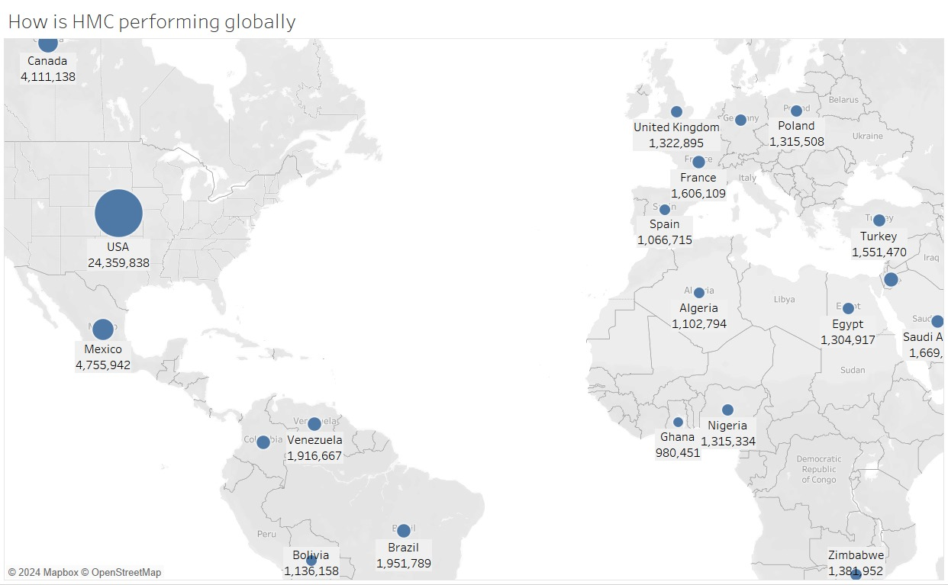
HMC Global Performance
Top Performing Region:
USA largest contributor
Stands out with 24,359,838 units sold
Significantly higher than any other region
High Performing Regions:
Mexico: 4,755,942 units sold
Canda: 4,111,138 units sold
Indicating a strong North American presence

Slide 6
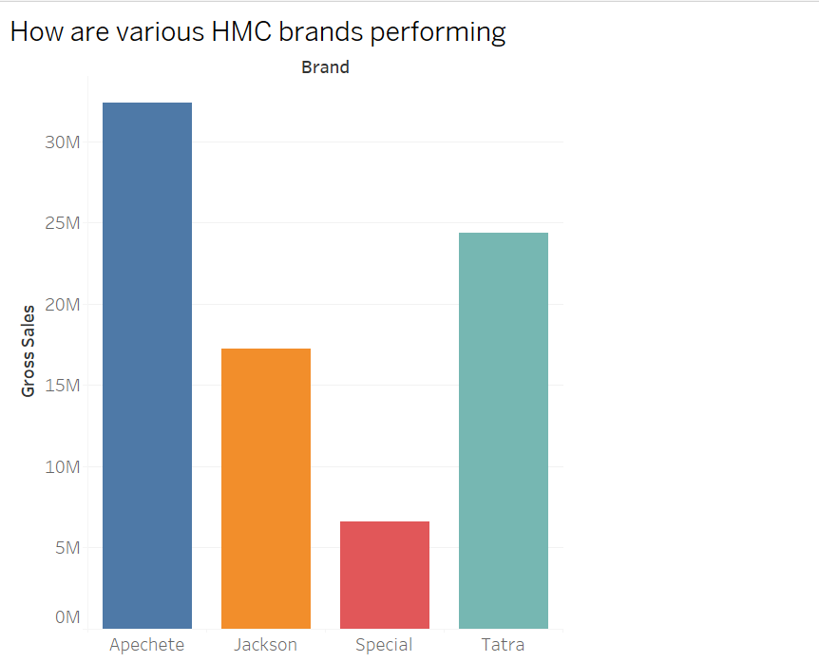
HMC Brand Performance
HMC Brands Gross Sales
Apechete: Leading with gross sales over 30 million.
Tatra: Second highest performer with sales nearing 25 million.
Jackson: Mid-tier performer with sales around 17 million.
Special: Lowest performer, with sales just above 6 million.
Key Insights
Apechete and Tatra dominate in gross sales.
Jackson performs moderately, but significantly lower than the top brands.
Special lags far behind the other three brands.

Slide 7
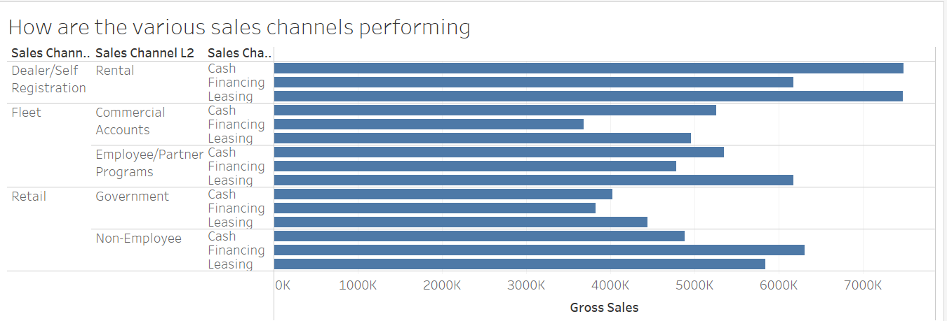
HMC Sales Channel Performance
Strong performance from Rentals
Fleet and Retail lag behind a bit
Overall Financing shows to be the least profitable

Slide 8
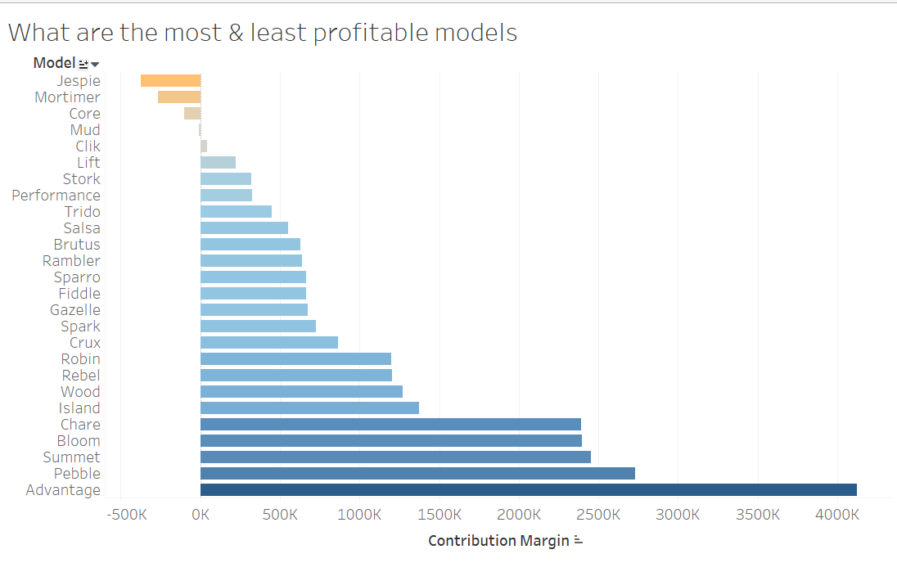
Model Profitability
Most Profitable:
Top Model - Advantage, CM of 4000K
High Performance - Pebble, Summer, Bloom, Chare
Least Profitable:
Bottom Model - Jespie, CM of -375K
Low Performance - Mortimer, Core, Mud

Slide 9
Financial Analytics

Slide 10
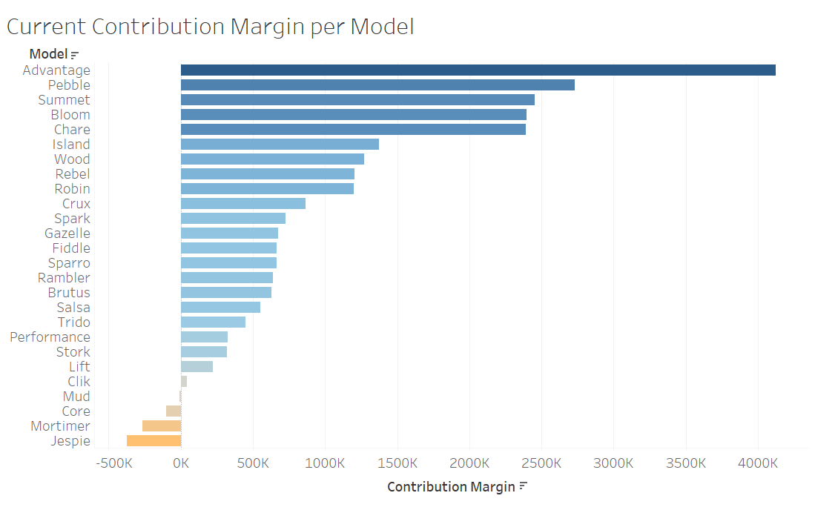
Current Contributions per Model
Top 5 Models (Highest Contribution Margin):
Advantage: ~4,000K
Pebble: ~2,500K
Summet: ~2,200K
Bloom: ~2,000K
Chare: ~2,000K
Bottom 5 Models (Lowest Contribution Margin):
Jespie: ~-500K
Mortimer: ~-400K
Core: ~-250K
Mud: ~-100K
Clik: ~0K

Slide 11
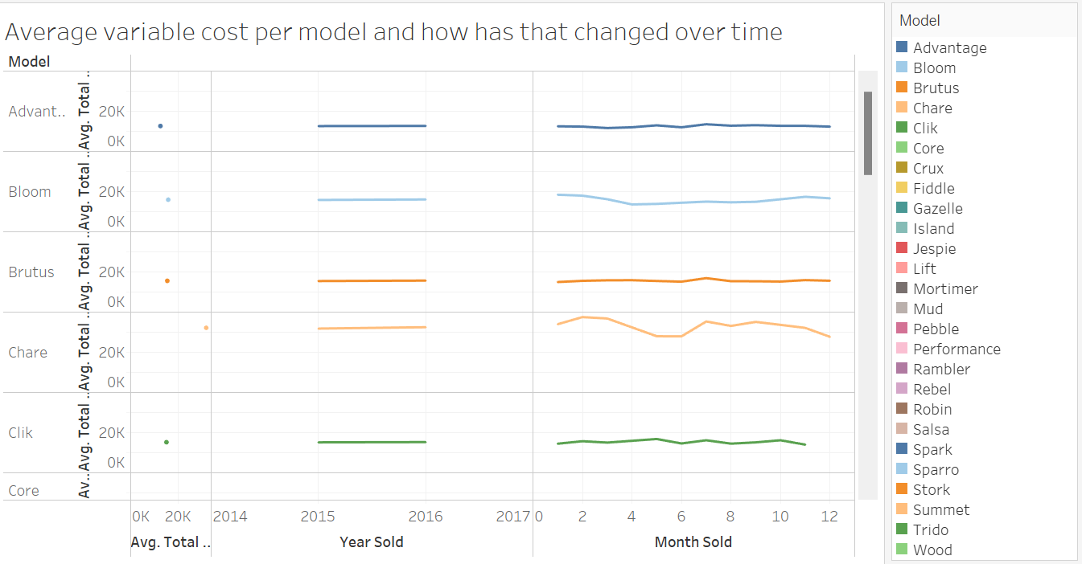
Average Variable Cost per Model Over Time
Trends:
Advantage: Mostly constant
Bloom: Slight decrease then stabilized
Brutus: Consistent, minimal fluctuation
Chare: Noticeable decrease in cost over time
Clik: Costs remain low over the time period
Core: Costs stayed flat and low the entire time period

Slide 12
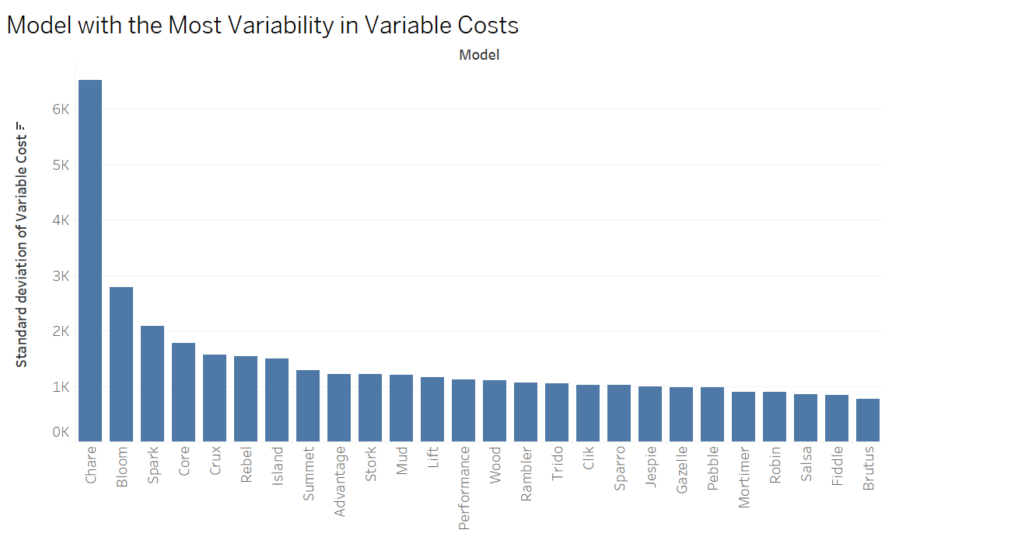
Model Cost Variability
The model with the most variability in variable costs is Chare, as it has the highest standard deviation (over 6K), significantly greater than all other models.
Bloom and Spark follow, but their variability is much lower, around 3K and 2K, respectively.
Other models show a steady decline in variability, with Brutus having the least variation.

Slide 13
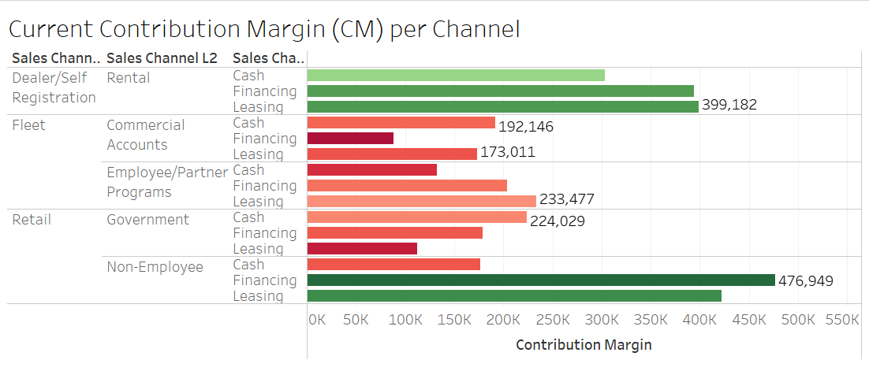
Contribution Margin per Channel
Current CM
Dealer/Self Registration (Rental):
Highest CM: Cash - 399K
Fleet (Commercial Accounts):
Highest CM: Cash - 192K
Employee/Partner Programs:
Highest CM: Cash - 233K
Retail (Government)
Highest CM: Cash - 230K
Non-Employee
Highest CM: Cash - 477K
*Cash is the highest in all channels, leasing tends to be the lowest.

Slide 14
Operational Analytics

Slide 15
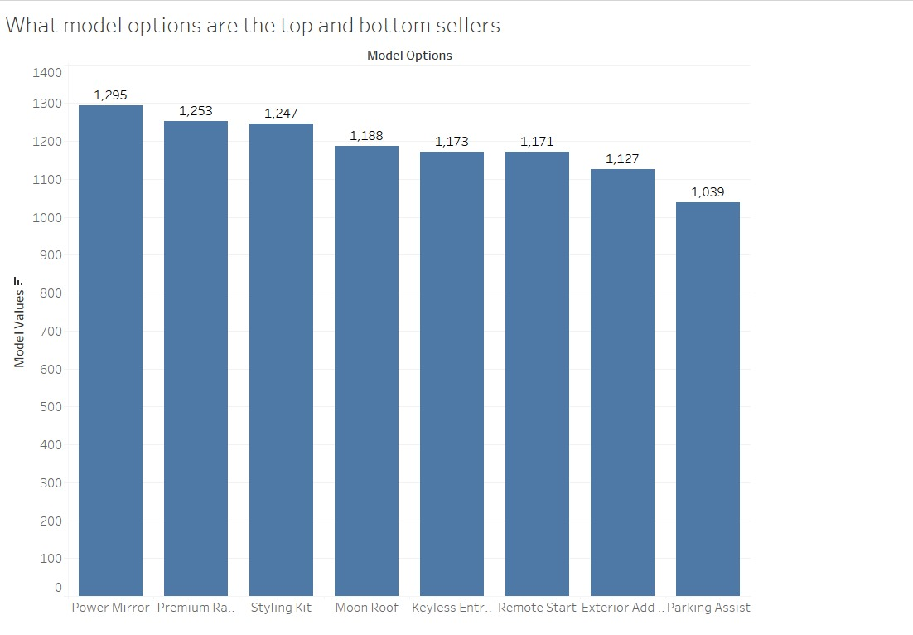
Model Top and Bottom Sellers
Top Model Options (Best Sellers):
Power Mirror: 1,295 units sold (highest seller).
Premium Radio: 1,253 units sold.
Styling Kit: 1,247 units sold.
Middle Sellers:
Moon Roof: 1,188 units sold.
Keyless Entry Keypad.: 1,173 units sold.
Remote Start: 1,171 units sold.
Bottom Model Options (Least Sellers):
Exterior Add-On: 1,127 units sold.
Parking Assist: 1,039 units sold (lowest seller).

Slide 16
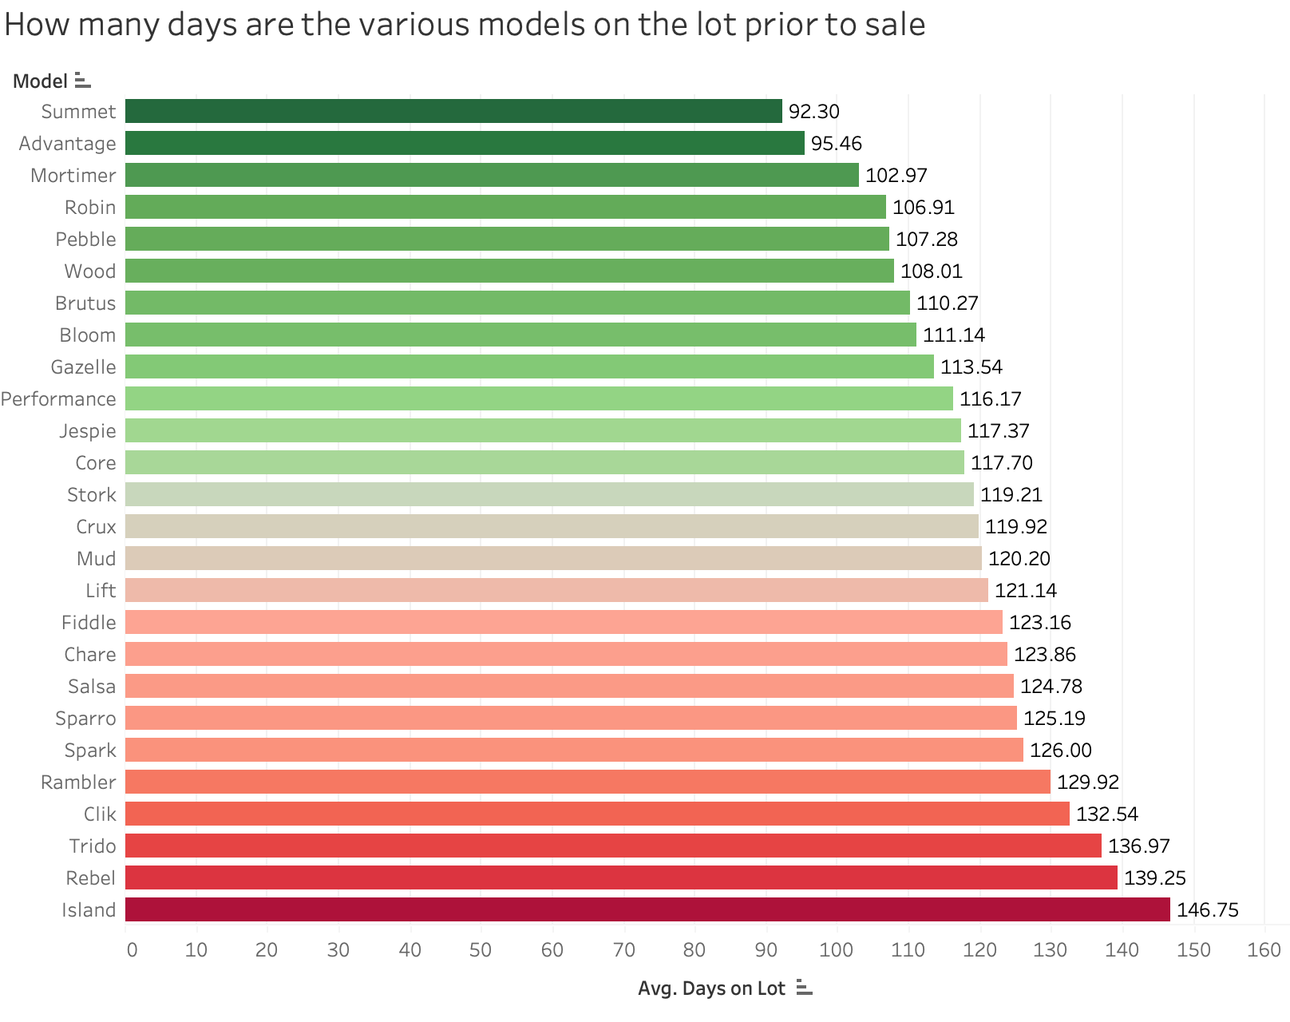
Days Spent on Lot by Model
Insights:
The Island model has the longest
average time on the lot at 146.75 days.
The Summet model has the shortest average time, slightly below 95.46 days (Mortimer).
Models like Island, Rebel, and Trido tend to stay significantly longer than others.

Slide 17
Forecast

Slide 18
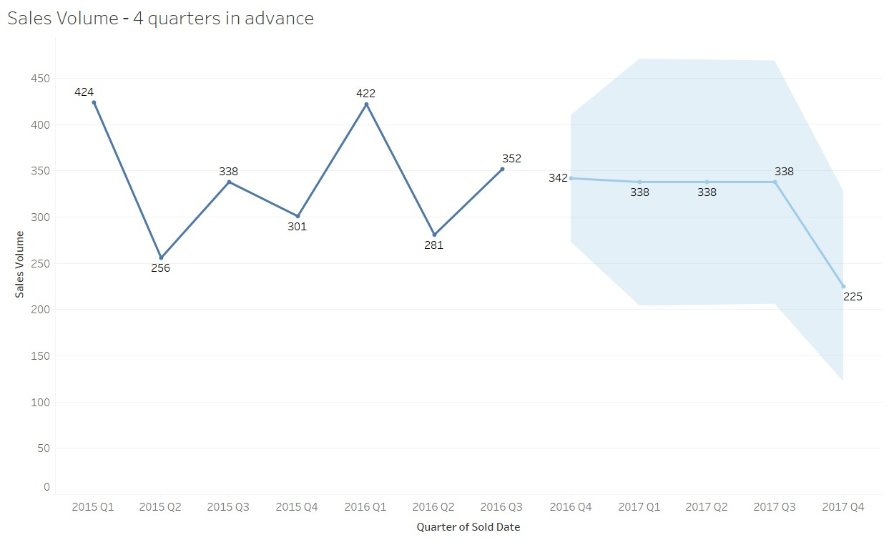
Sales Volume - Next 4 Quarters
Historical Sales Volume:
Peaks at 424 in 2015 Q1 and 422 in 2016 Q1.
Lowest recorded value is 256 in 2015 Q2.
Fluctuations are visible, indicating seasonal or market-related variations.
Forecasted Data:
Sales are expected to stabilize at 338 for three quarters (2017 Q1 to 2017 Q3).
A sharp decline to 225 is projected by 2017 Q4.
The light blue shaded area represents the forecast's confidence interval, showing potential variability.

Slide 19
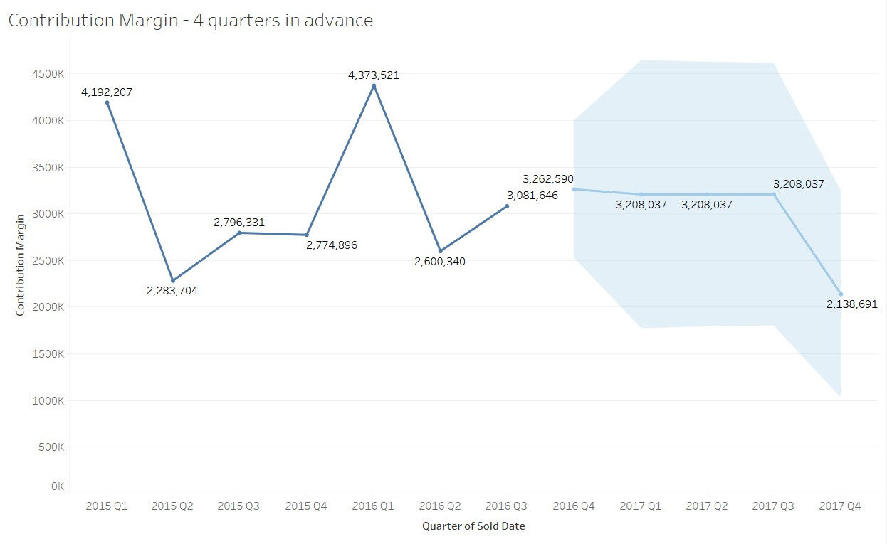
Contribution Margin - Next 4 Quarters
Historical Contribution Margin:
The highest recorded margin is 4,373,521 in 2016 Q1.
The lowest margin is 2,283,704 in 2015 Q2.
Significant fluctuations are evident, with a steep rise between some quarters (e.g., 2015 Q2 to Q3) and sharp declines (e.g., 2016 Q1 to Q2).
Forecasted Contribution Margin:
The forecast predicts stability around 3,208,037 from 2017 Q1 to Q3.
A sharp drop to 2,138,691 is projected by 2017 Q4.
The light blue shaded region reflects uncertainty, with increasing variability further into the forecast.

Slide 20
Recommendations

Slide 21
Recommended Course of Action for HMC
Increase focus on successful regions and brands
Eliminate or reengineer unprofitable models and options
Address cost inefficiencies
Align inventory with market demand
Prepare for financial and non-financial implications

Slide 22
Potential Implications of Recommended Actions
Financial Implications
Increased profitability from enhanced focus on profitable models and regions
Cost savings from discontinuation of unprofitable models and low-demand options
Potential short-term revenue loss from discontinued operations
Non-Financial Implications
Narrowing focus to high profitability areas could damage customer relations and distract from emerging markets
Possible risk of fracturing relationships with dealers who have to sell the products
Operational adjustments will be needed to acclimate to the focus of the highly profitable models and regions

Slide 23
Conclusion
The financial benefits of these actions, including improved margins, cost efficiency, and revenue optimization, outweigh the short-term risks if managed effectively
HMC must proactively address non-financial implications through strategic communication, dealer incentives, and careful planning to ensure stakeholder alignment and maintain its competitive edge.

